Slide 1
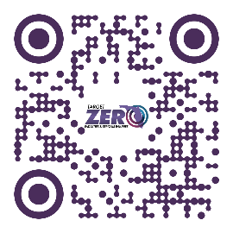
DID YOU
KNOW?
Scan QR Code to find your perfect
(and safe) fit!
Wearing the right helmet makes a safety difference!
66% of Florida riders ages 50+ involved in fatal motorcycle crashes were not wearing USDOT- compliant helmets.*
RIDER AGE GROUPS USING NON-COMPLIANT HELMETS
Under Age 30
35%
Age 30-49
56%
Age Age 50+
66%

