Slide 1
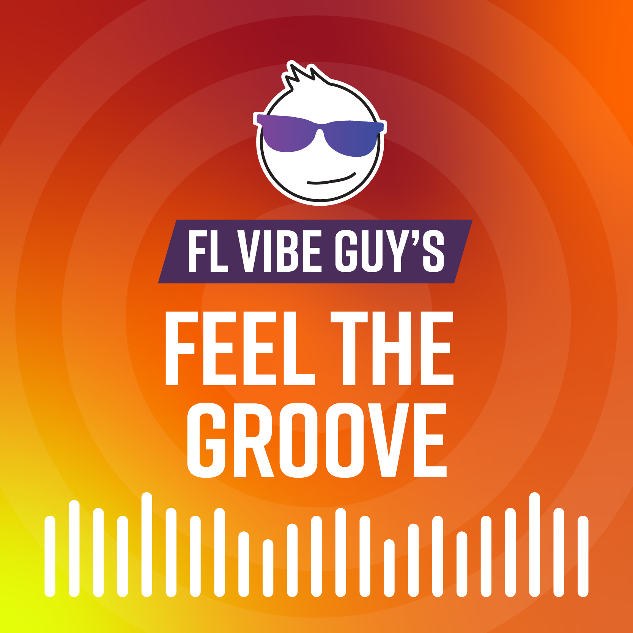
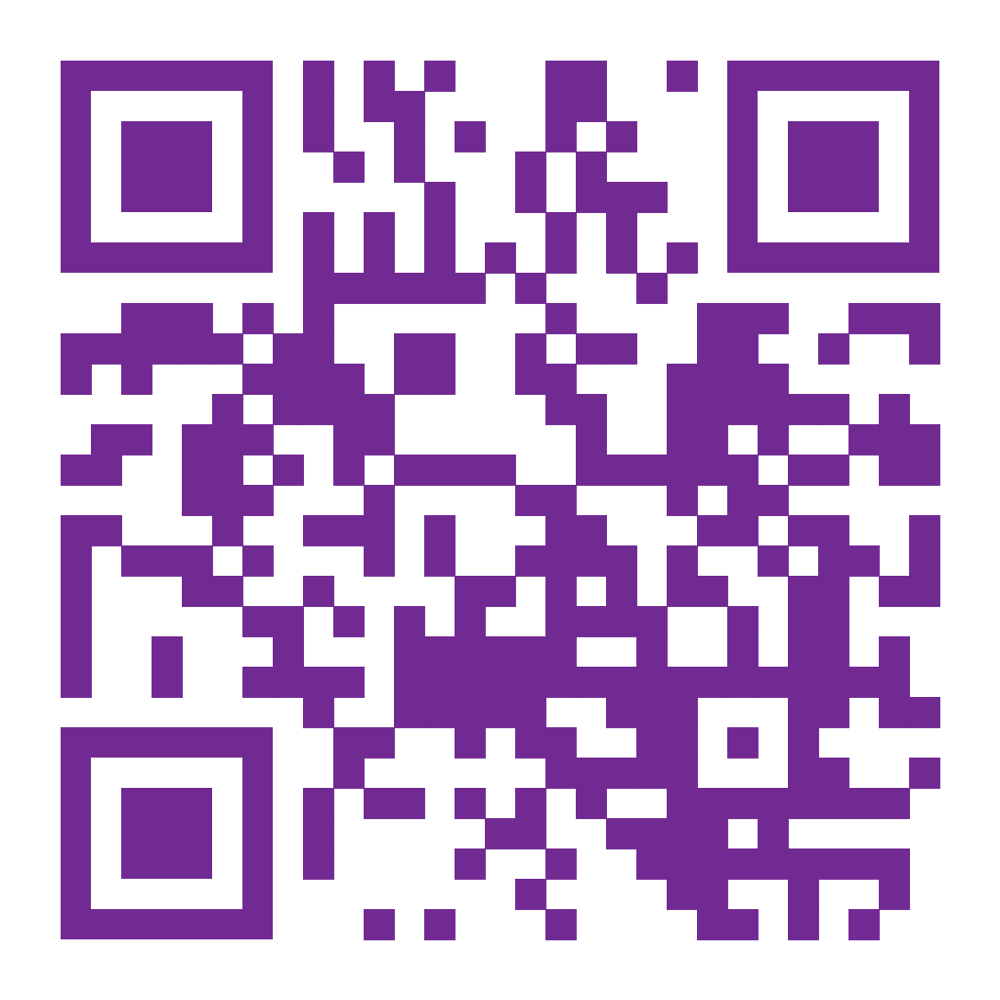
Feeling tired while driving?
Wipe away fatigue with these Target Zero playlists!
A pop-centric playlist of upbeat, positive songs!
Coldplay, Harry Styles,
Post Malone, Ed Sheeran and more
Hits from every era, something for everyone!
The Beatles, Bob Marley,
The Beach Boys, Toto, Elton John and more
Let’s Get Everyone Home Safely
TargetZeroFL.com
Notes:
Each year, the first week of September is designated as Florida’s Drowsy Driving Prevention Week. If you find yourself or others feeling tired while driving, try out these Target Zero playlists!

