Slide 1
*****
In a national survey,
over 30% of drivers admit to running a red light in the past 30 days (AAA)
Let’s Get Everyone Home Safely
by always stopping on red
NATIONAL STOP ON RED WEEK 2024
August 4 – 10
Help spread the word on social with #ZeroInOnRed and #TargetZeroFL
Notes:
When approaching a traffic signal always remember to S.T.O.P. on RED – Stop, Think, Observe, then Proceed on green when the intersection is clear.
Intersection crashes are a particular safety concern in Florida and improving intersection safety is one of the emphasis areas of our Strategic Highway Safety Plan.
Always Stop on Red: It’s the law, and it saves lives. Especially when you are in your FDOT vehicle, set a good example and always stop on red.

Slide 2
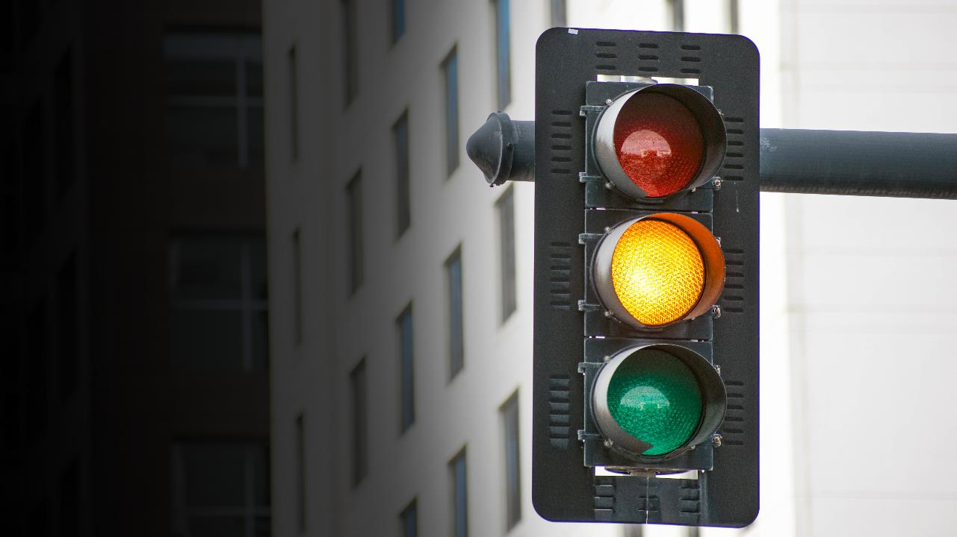
THINK AHEAD
STOP ON RED
You have less than two seconds to decide how you will react when approaching an intersection that goes from green to yellow. Over 30% of all traffic fatalities occur from intersection-related crashes*. Avoid distractions and stay alert so you’re able to make a safe decision quickly. It Could Save Your Life.
Let’s Get Everyone Home.
Help spread the word on social with #ZeroInOnRed and #TargetZeroFL
*Sourced from the Florida Department of Transportation
Notes:
When approaching a traffic signal always remember to S.T.O.P. on RED – Stop, Think, Observe, then Proceed on green when the intersection is clear.
Intersection crashes are a particular safety concern in Florida and improving intersection safety is one of the emphasis areas of our Strategic Highway Safety Plan.
Always Stop on Red: It’s the law, and it saves lives. Especially when you are in your FDOT vehicle, set a good example and always stop on red.

