Slide 1
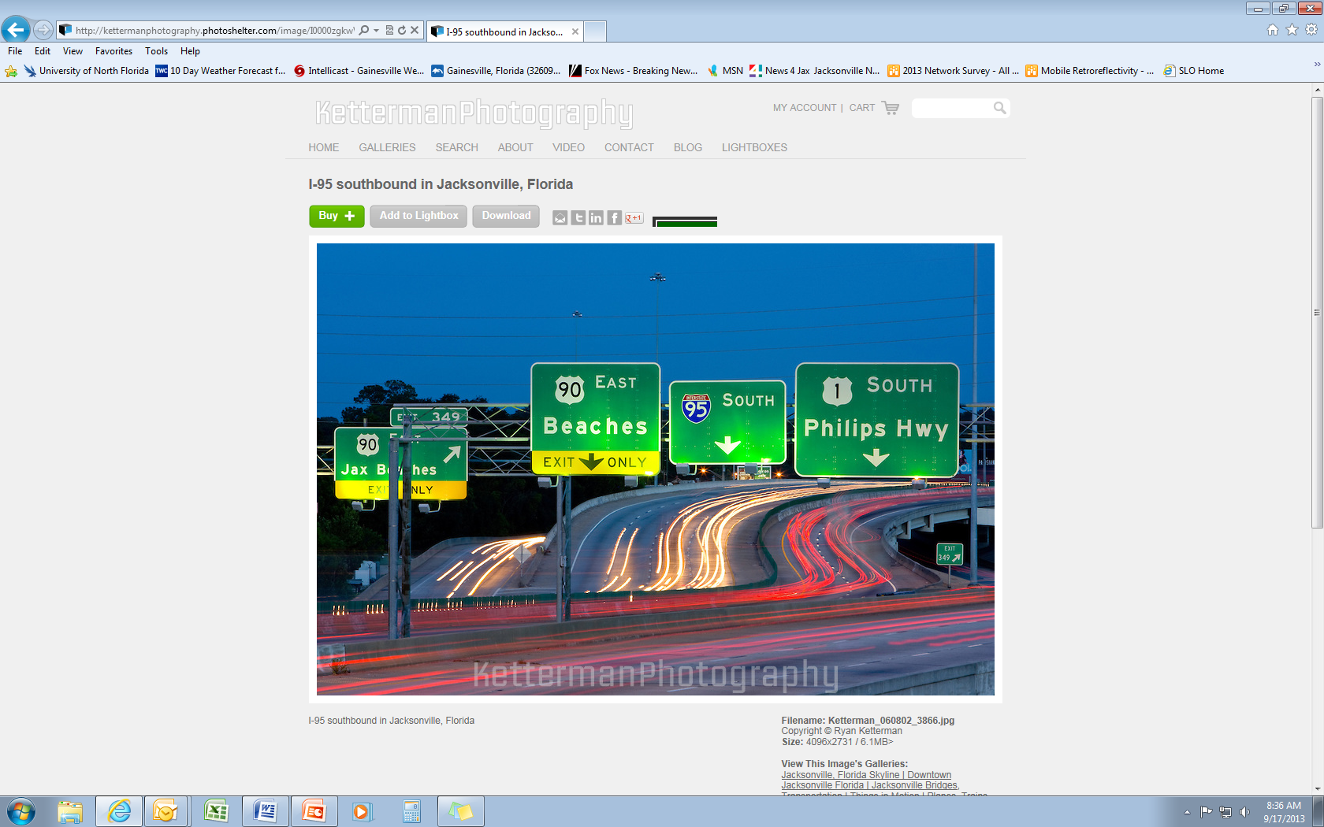
FDOT High Friction Surface Treatment Program
Pilot Intersection Safety Initiative

Slide 2
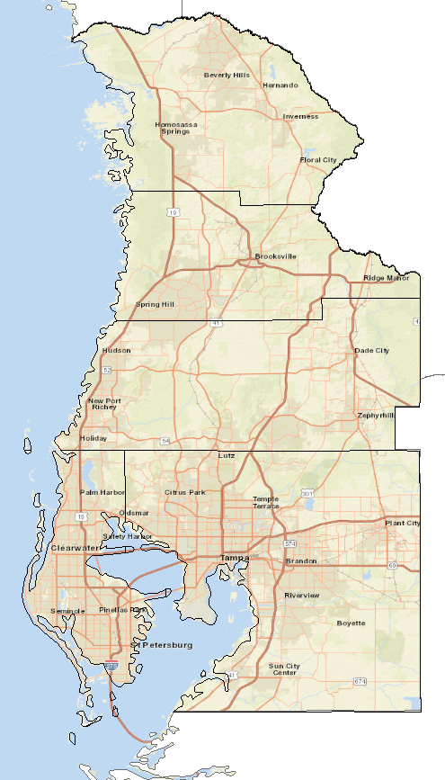




Road Safety Audit (RSA) Pilot Program
FHWA Pilot Program with Virginia Tech Transportation Institute (VTTI) & FDOT
  New continuous friction measuring system – fancy ☺
  Measurements taken along corridors across Florida in 2016
  Pavement Friction Management Program (PFMP)
  Florida selected as a focus state
In support of Vision Zero: Develop and demonstrate safety improvements through proactive Pavement Friction Management Program (PFMP)
Every Day Counts Proven Safety Countermeasure
Notes:
FHWA Pilot Program with Virginia Tech Transportation Institute (VTTI) & FDOT
New continuous friction measuring system – fancy ☺
Measurements taken along corridors across Florida in 2016
Pavement Friction Management Program (PFMP)
Florida selected as a focus state
In support of Vision Zero: Develop and demonstrate safety improvements through proactive PFMP
District 7 RSAs with 5 locations in early 2019
Every Day Counts Proven Safety Countermeasure

Slide 3
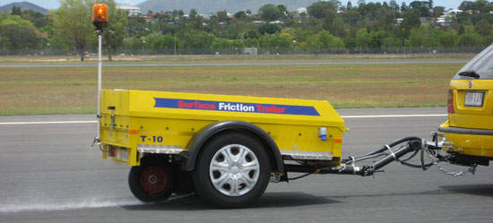
FHWA RSA Pilot Program – Objectives
Reduce the risk and severity of crashes that might be affected by pavement friction
Identify opportunities to promote positive guidance
Identify opportunities to enhance pavement life and friction characteristics
Demonstrate proven continuous friction measurement equipment

Slide 4
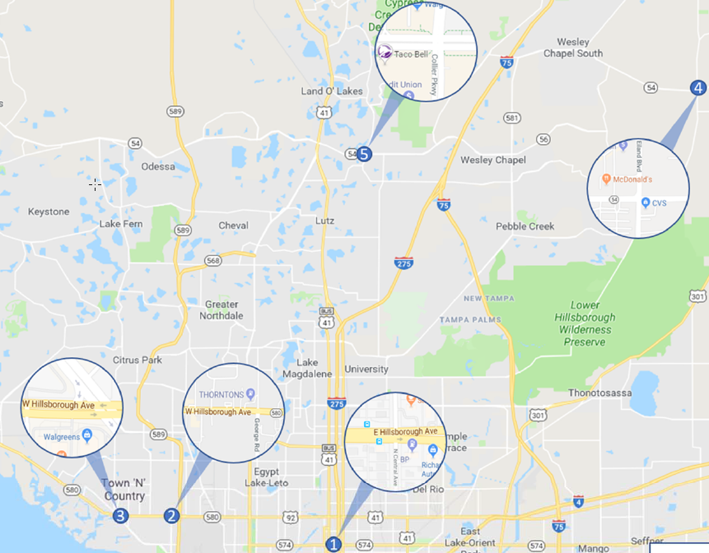
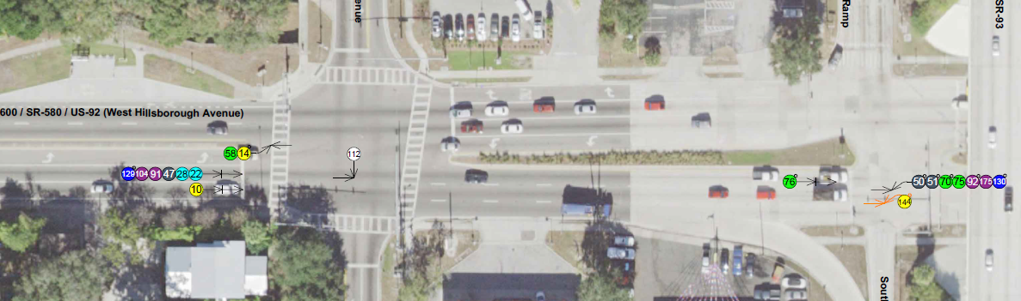
FHWA RSA Pilot Program – FL Locations
Prioritized locations:
  Crash data analysis
  Pavement friction data
  Planned resurfacing projects
  Other potential safety improvements

Slide 5
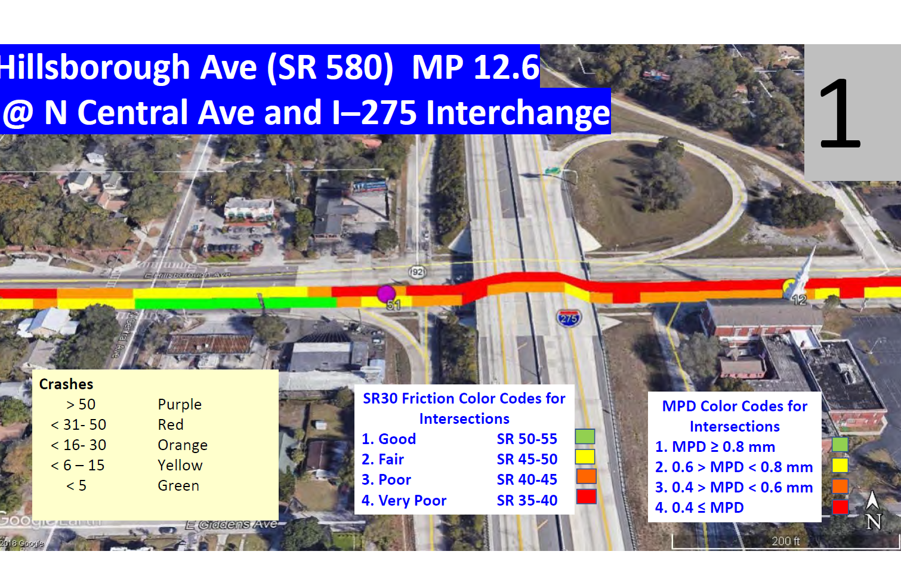
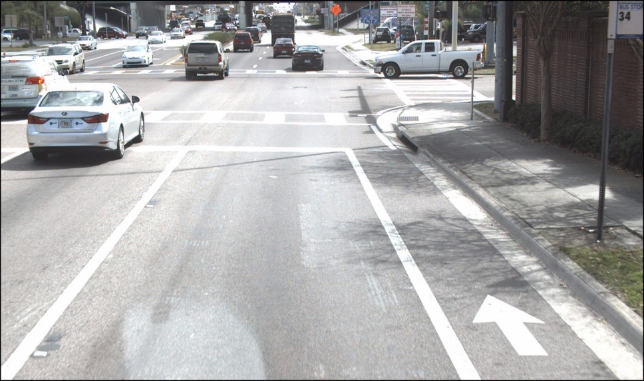
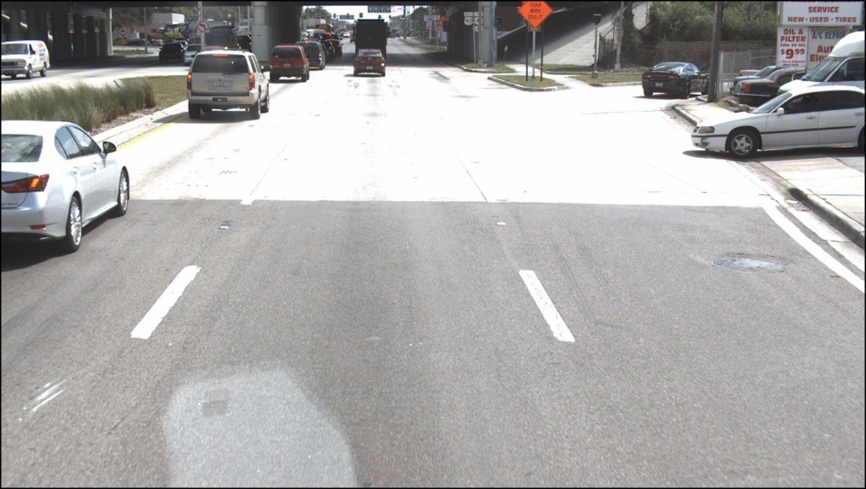
FHWA RSA Pilot Program – Pavement Conditions
SPD: Sideways Force Friction; MPD: Mean Pavement Depth
SR 580 EB; MP 12.55 SR30 44.1
MPD 0.34

Slide 6
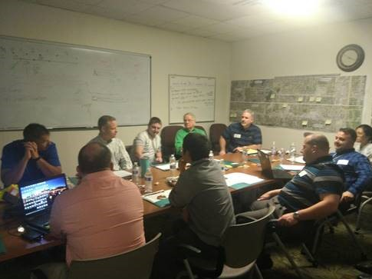
FHWA RSA Pilot Program – RSA Process
Broke into teams
Completed field reviews
  Noted observations
  Skid marks?
  Crash debris?
  Any rutting or shoving of pavement?
Determined next steps and potential enhancements

Slide 7
FHWA RSA Pilot Program – RSA Process
Incorporate other short-term, low-cost safety enhancements
  Hillsborough Ave (SR 580) at Sheldon Road
    Missing leg crosswalks at Sheldon Road
    Missing leg crosswalk at Lagoon Street (500 feet west of Sheldon Road)
    Enhance “free-flow” right-turn for southbound movement
High friction surface treatment only:
  Hillsborough Ave (SR 580) at Central Avenue
  Hillsborough Ave (SR 580) at George Road

Slide 8


FHWA RSA Pilot Program – Implementation
Understand refined HFST implementation process
Develop conceptual plans
Initial quantities
Cost estimates by implementation method:
  Fast Response
  Design-Build Push Button
  Design, Bid, Build (conventional)

Slide 9
FHWA RSA Pilot Program – Implementation Approaches in Florida
Fast-Response Contracts
  $250,000 contract maximum
  “Construction Only”
Design-Build Pushbutton Contract
  $1,000,000 task limit
  Set pay item prices ($250 per square yard for HFST ☹)
Conventional Design, Bid & Build

Slide 10
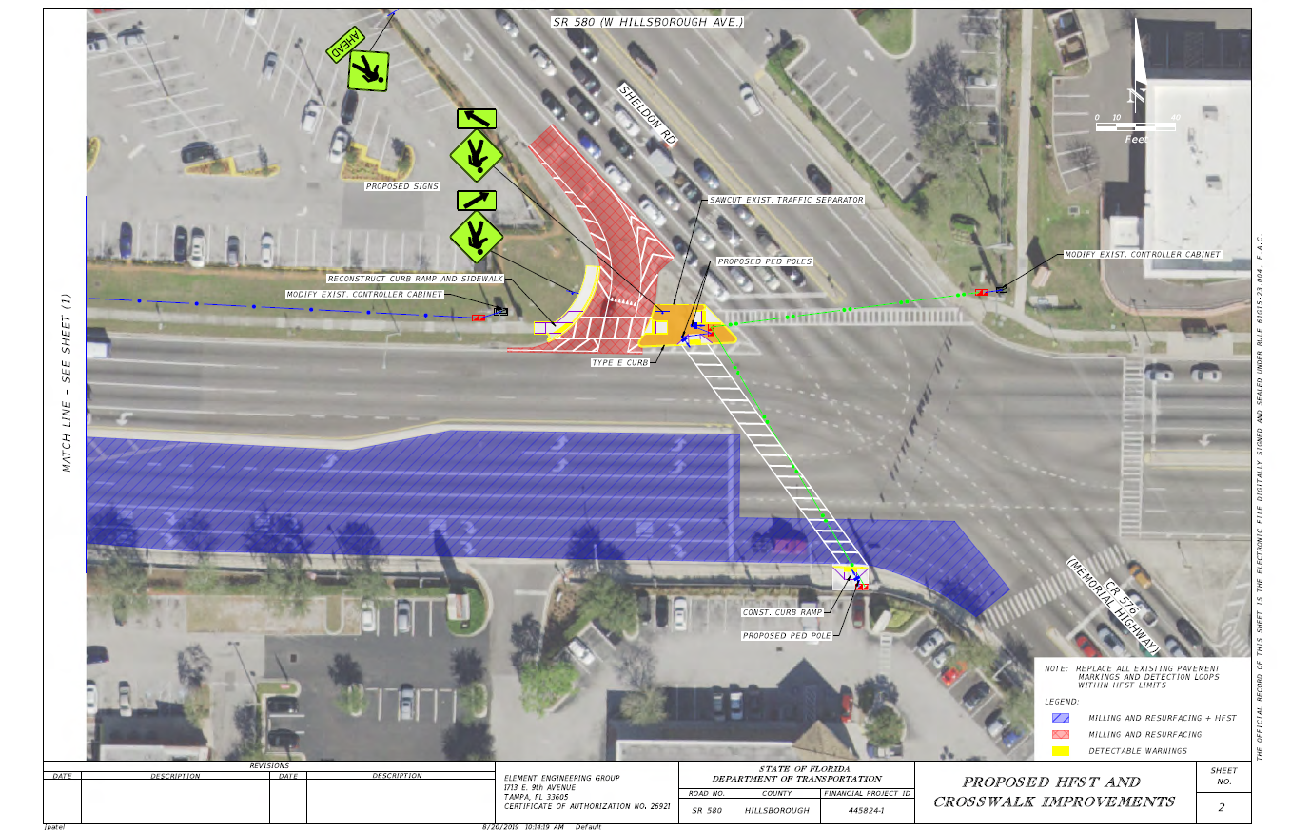
FHWA RSA Pilot Program – Concept Plans

Slide 11
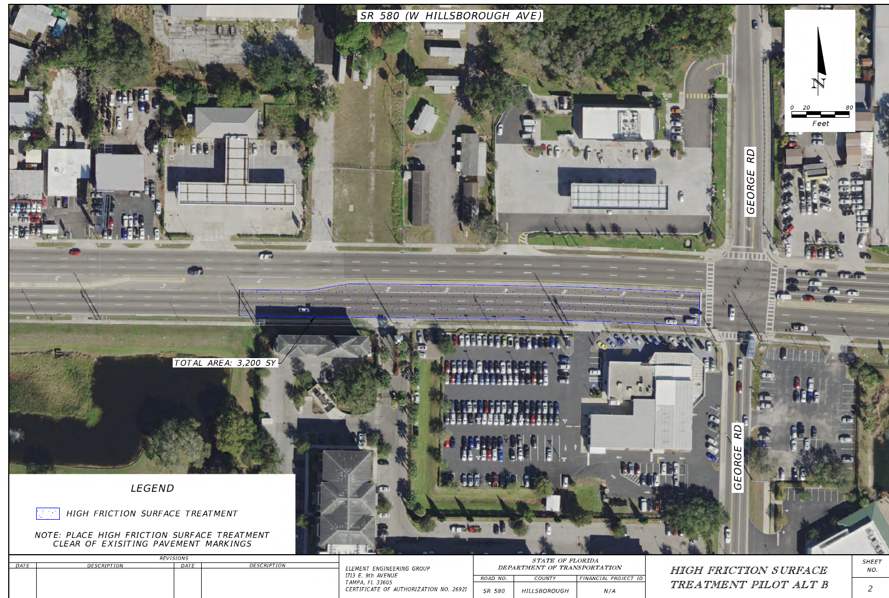
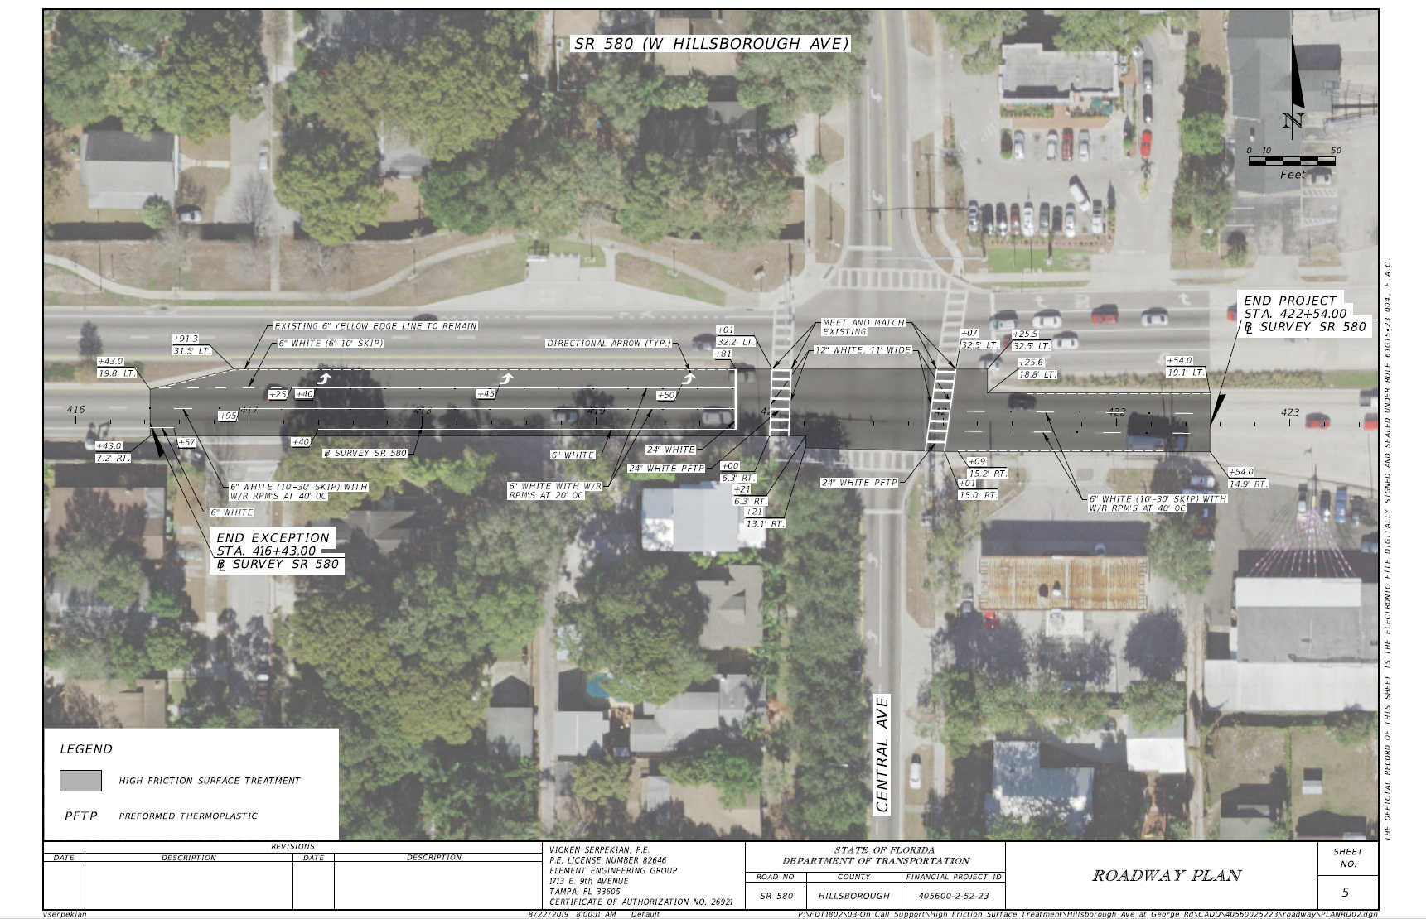
FHWA RSA Pilot Program – Concept Plans

Slide 12
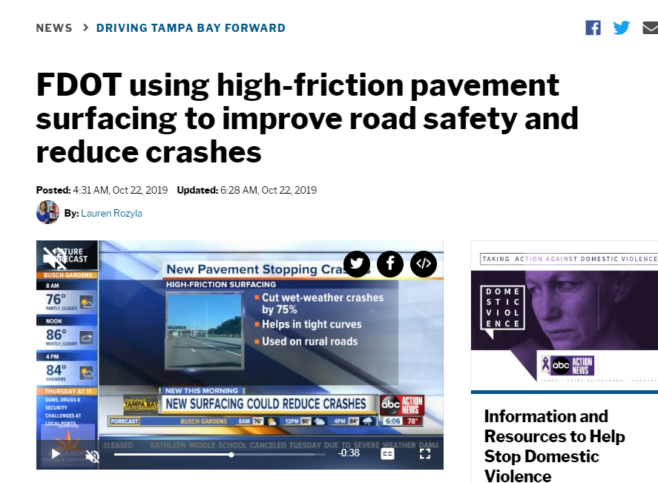
FHWA RSA Pilot Program – Telling the Story
Notes:
Engage Community Partners
abc Action News Story
Crash Reduction
Crash reductions of 69 percent in Kentucky across 25 sites
Previous location with HFST in District 7 – SR 60 ramp
Wet-Weather Crashes – 73 percent reduction
Run-off-the-road Crashes – 53 percent reduction
Overall Crashes – 67 percent reduction

Slide 13
FHWA RSA Pilot Program – Next Steps
Include HFST in next Design Build Pushbutton Contract
Continue to monitor previous installation locations
Implement additional locations
  Hillsborough Ave (SR 580) at Sheldon Road; Conventional Contract Letting 4/29/2020
  Hillsborough Ave (SR 580) at George Road & Central Ave; Fast Response Contract Construction in 6 – 12 Months
Evaluate and monitor performance of additional locations
Notes:
Continue to monitor previous installation locations
Will help to develop larger data sets and additional lessons learned
Implement additional locations
Hillsborough Ave (SR 580) at Sheldon Road; Current letting date is April 29, 2020
Hillsborough Ave (SR 580) at George Road & Central Ave; Construction within 6 to 12 months pending approval of Fast-Response Contract
Evaluate and monitor performance of additional locations

Slide 14
Questions

