Slide 1
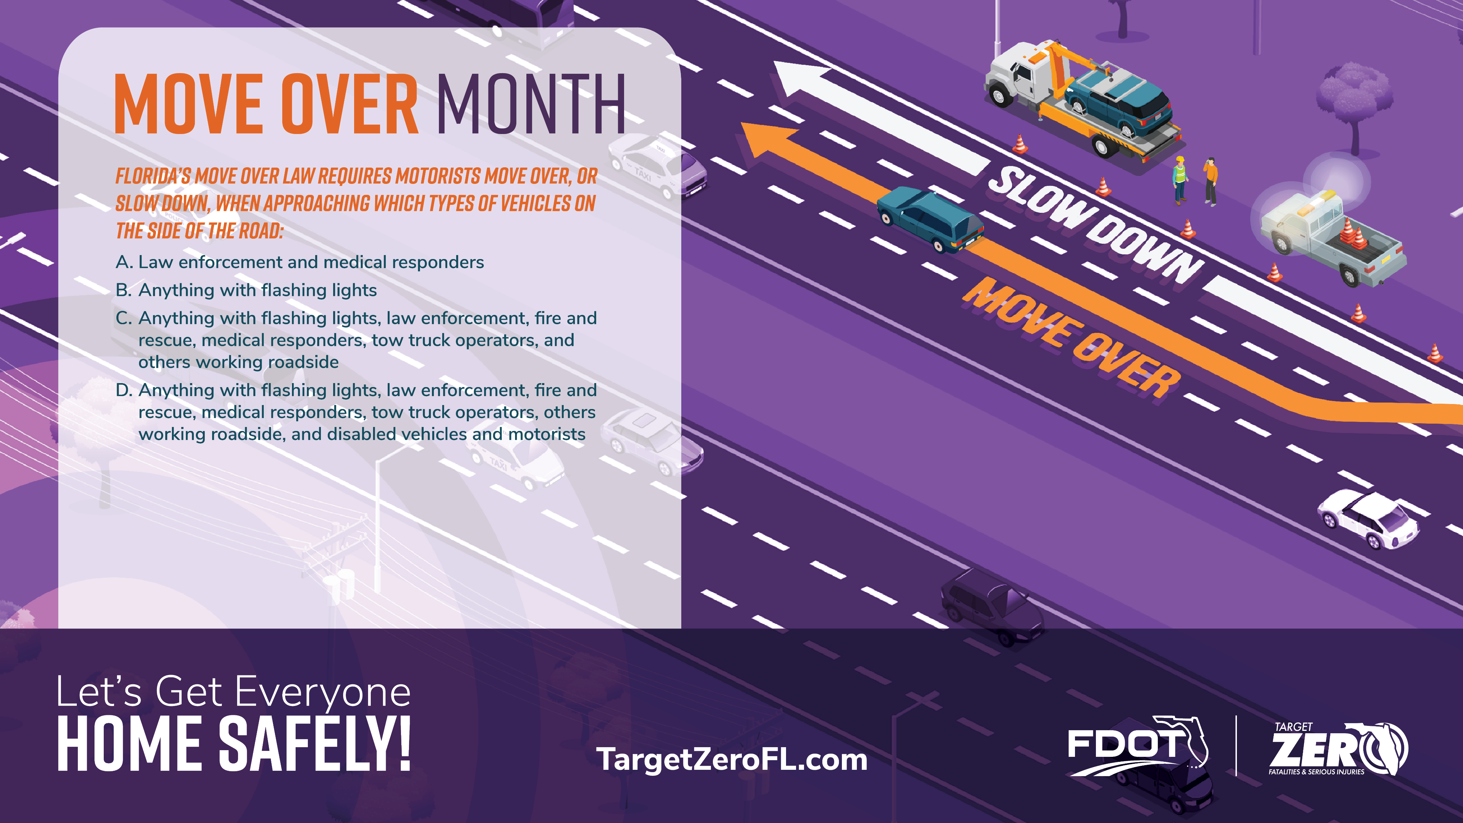

Slide 2
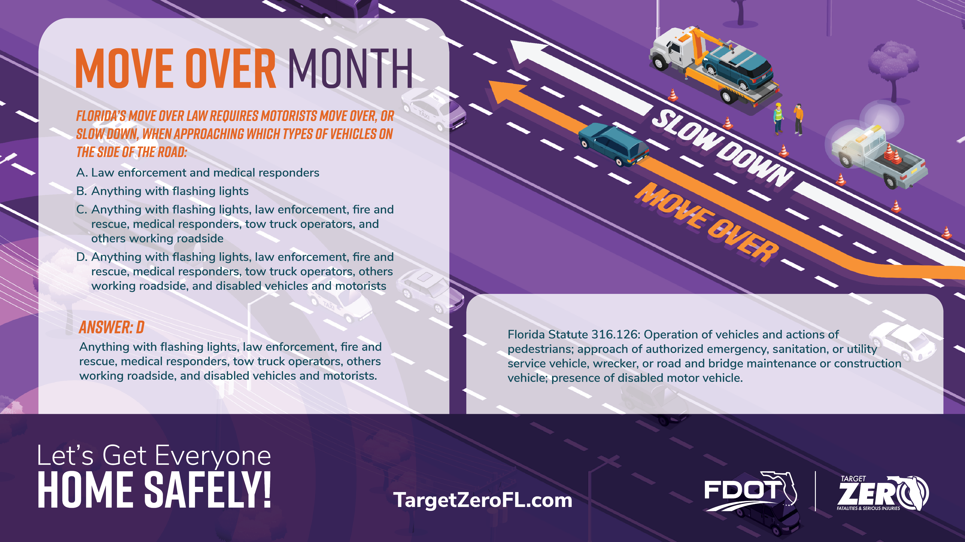
Notes:
The Answer is D:
Florida Statute 316.126: Operation of vehicles and actions of pedestrians; approach of authorized emergency, sanitation, or utility service vehicle, wrecker, or road and bridge maintenance or construction vehicle; presence of disabled motor vehicle.

Slide 3
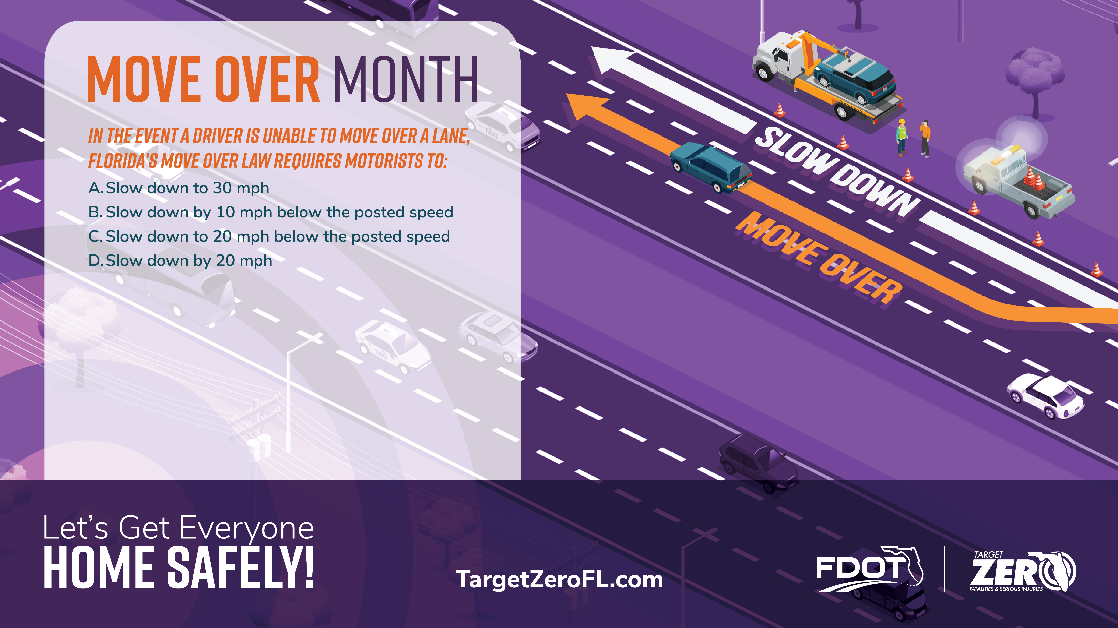

Slide 4

Notes:
The Answer is C:
Florida Statute 316.126 (2): Shall slow to a speed that is 20 miles per hour less than the posted speed limit when the posted speed limit is 25 miles per hour or greater; or travel at 5 miles per hour when the posted speed limit is 20 miles per hour or less, when driving on a two-lane road, except when otherwise directed by a law enforcement officer.

