Slide 1
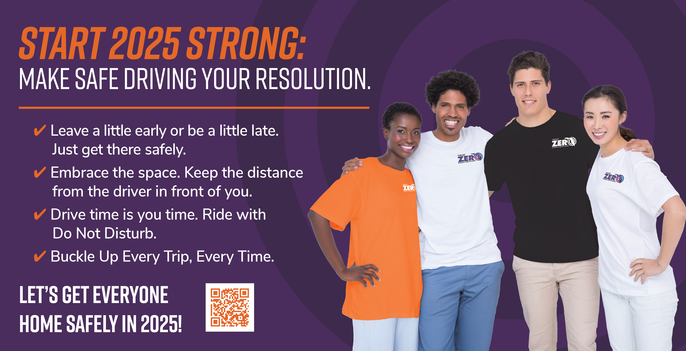
Notes:
Start 2025 Strong with our easy Target Zero everyday life habits that lead to safe driving behaviors:
Prevent speeding: Simply leave early or be a little late, just get there safely!
Prevent aggression: Embrace the space, both your calm space, and keep your distance from the driver in front of you
Prevent distraction: Make drive time YOU time, and ride with Do Not Disturb
As always, buckle up every trip, every time
Let’s get everyone home safely in 2025!
Use this QR code to access safe driving tools – custom do not disturb messages, and safe driving playlists!

