Slide 1
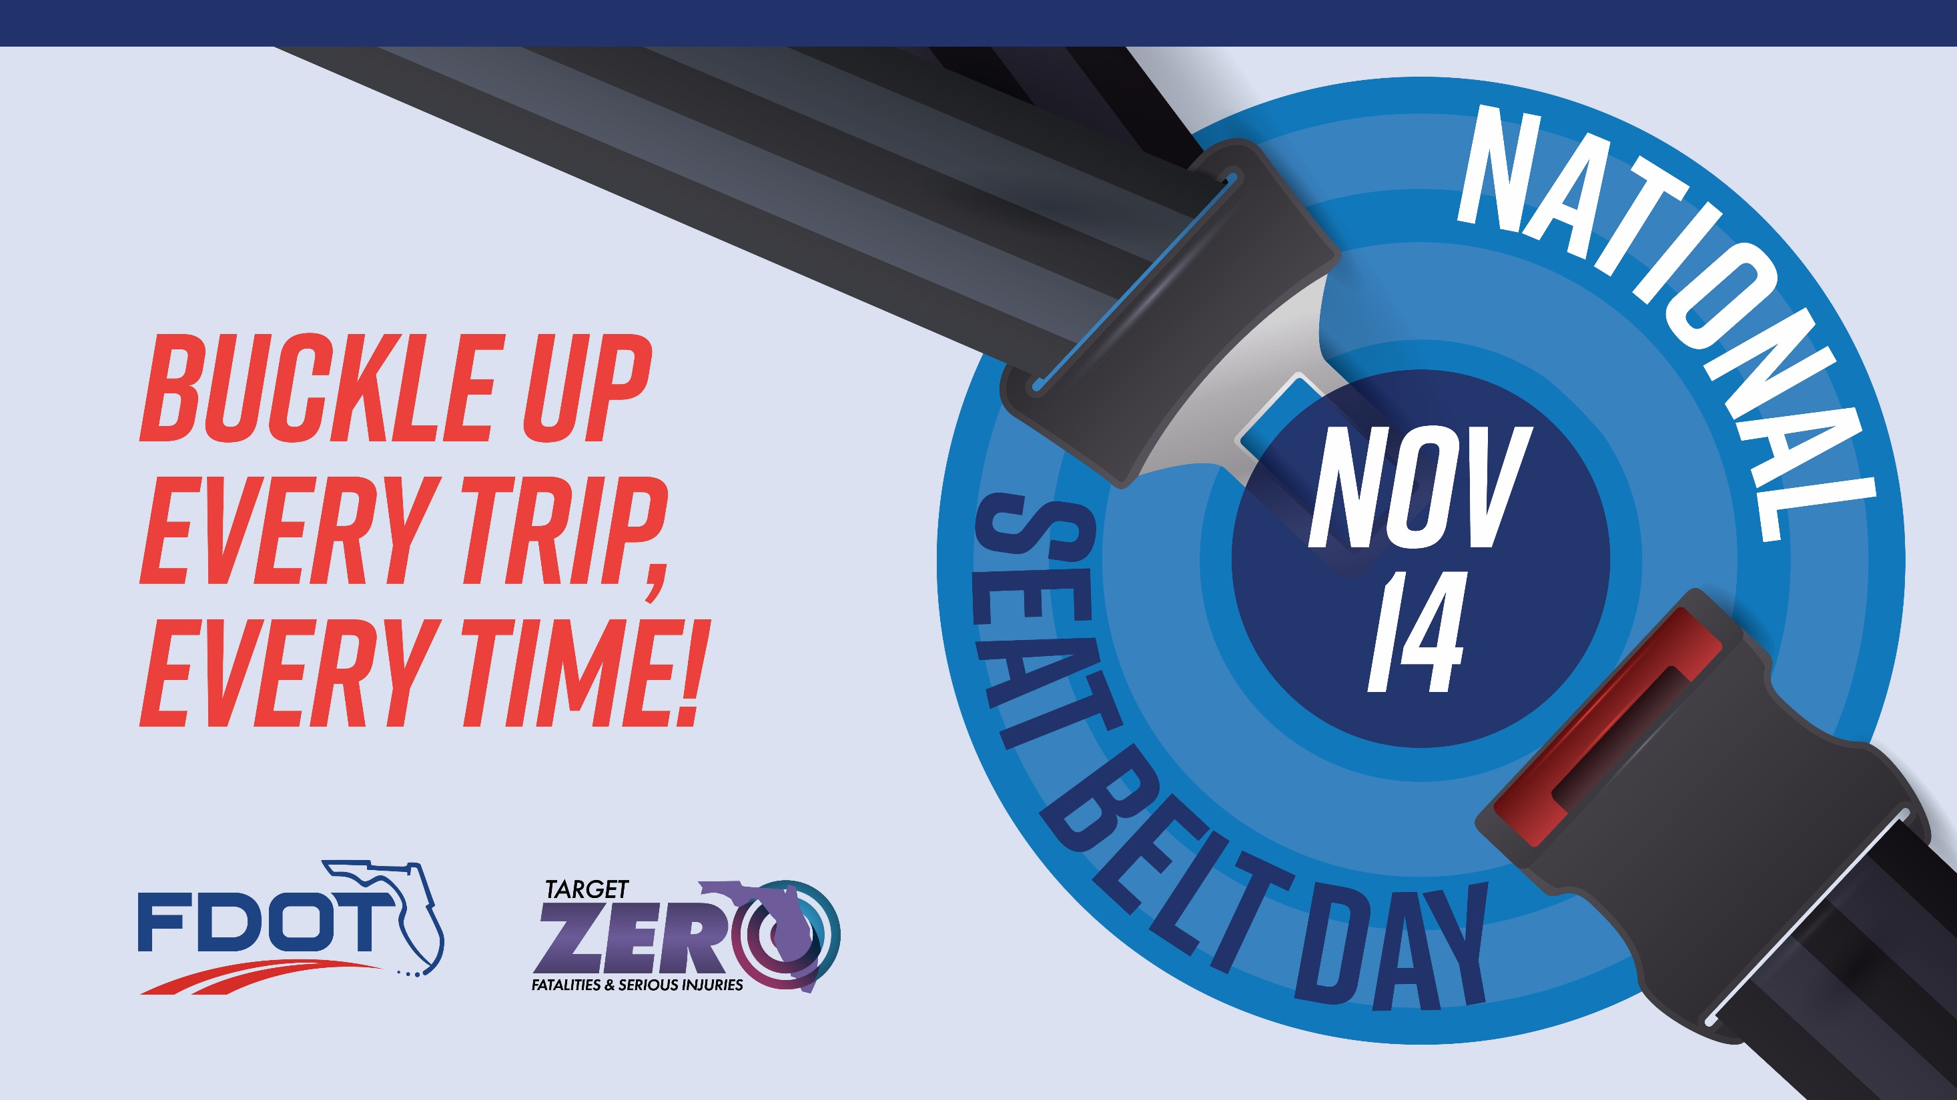
Notes:
Buckling up – It is a simple yet, live-saving action. On National Seat Belt Day, recognized each year on November 14, we support the mission of creating safer roadways across Florida by encouraging increased safety belt usage.
Every time you get into a vehicle, whether driving or riding as a passenger, fasten your safety belt. That single click greatly reduces the risk of serious injury or death in the event of a crash (source).
Safety belts save lives, but only if worn correctly every time you are in a motor vehicle. Wear your lap belt around your hips and wear your shoulder belt across your chest. The safety belt will not work if it is tucked behind you, and airbags are no substitute for safety belts.
For additional educational resources, visit FDOT’s Click it or Ticket and FLHSMV’s Buckle Up Florida, It’s the Law! web pages.

Slide 2
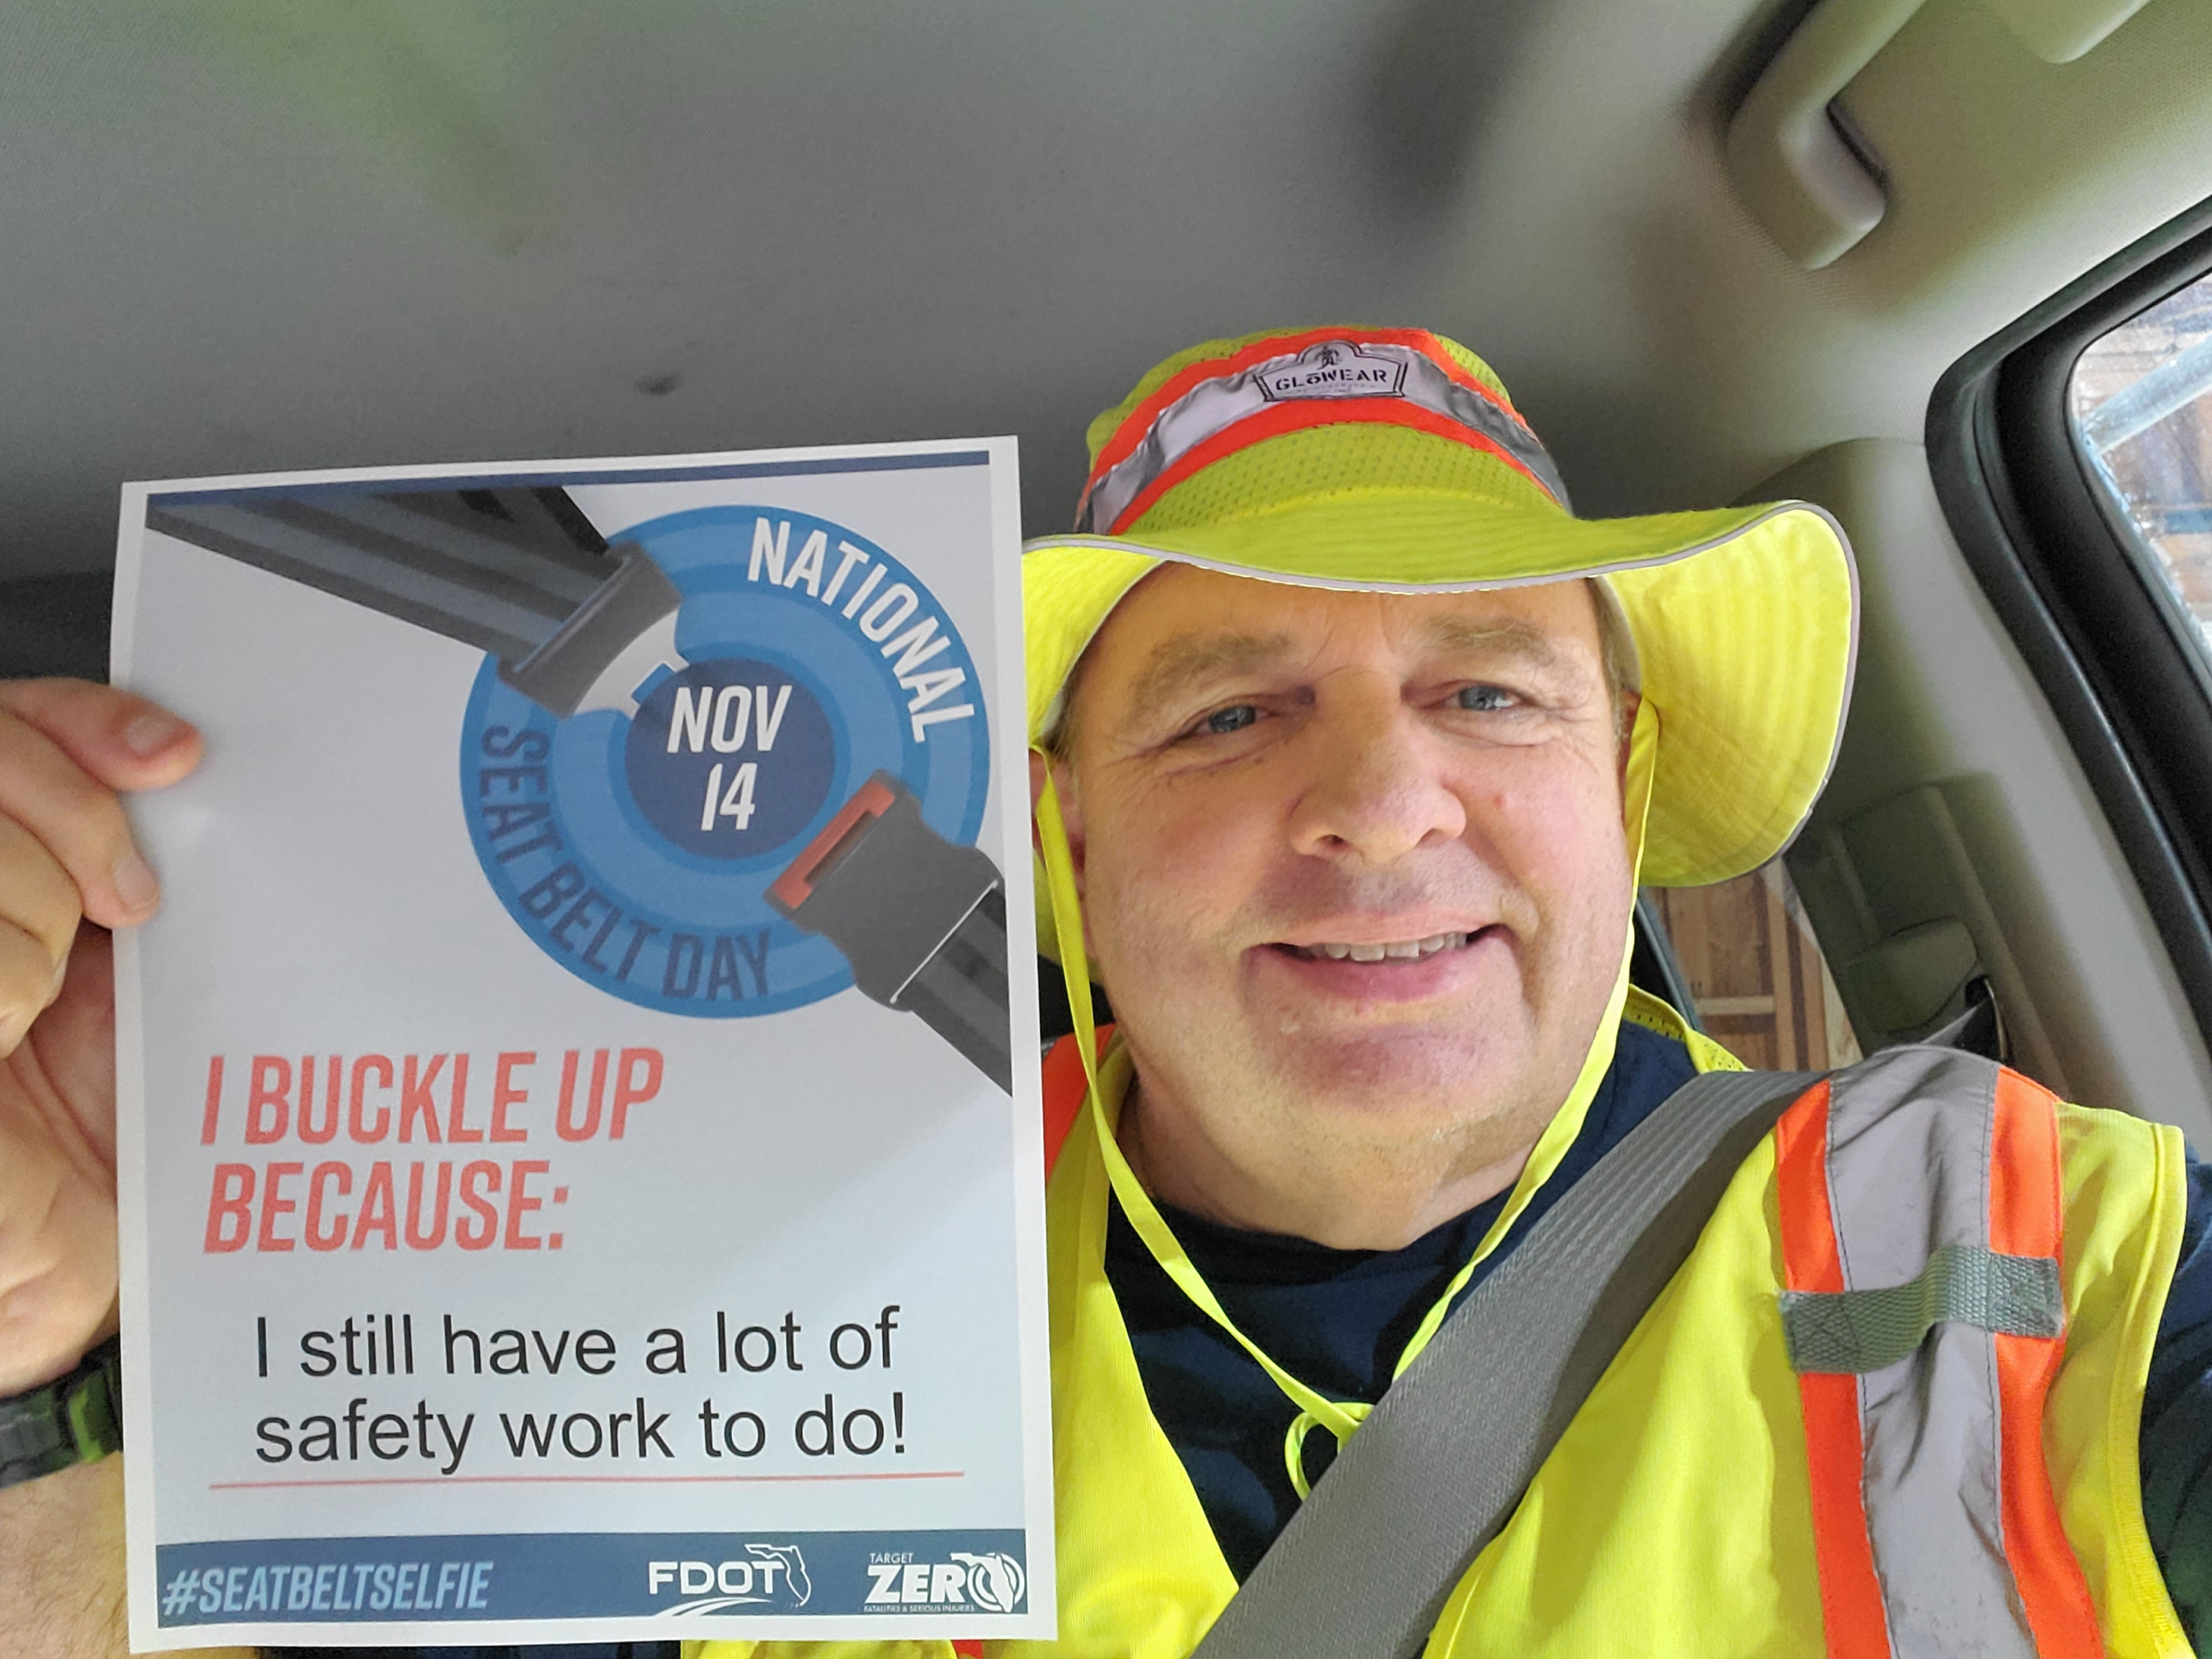
Show your support for National Seat Belt Day!
Send your #SeatBeltSelfie to: TargetZeroTeam@dot.state.fl.us
Notes:
Say Cheese! Take a #SeatBeltSelfie and share it with the Target Zero community to help bring awareness to National Seat Belt Day! Print and fill out the Target Zero “Seat Belt Selfie Prop” to hold up in your selfie. This special note captures your unique answer to the question, “Why do you buckle up?”.
Park in a safe location before using your phone. Snap a selfie with your safety belt properly buckled and email it to us at TargetZeroTeam@dot.state.fl.us!
You can also take your message online. Post your Seat Belt Selfie on social media using #SeatBeltSelfie and #TargetZeroFL to inspire others to buckle up.

