Slide 1
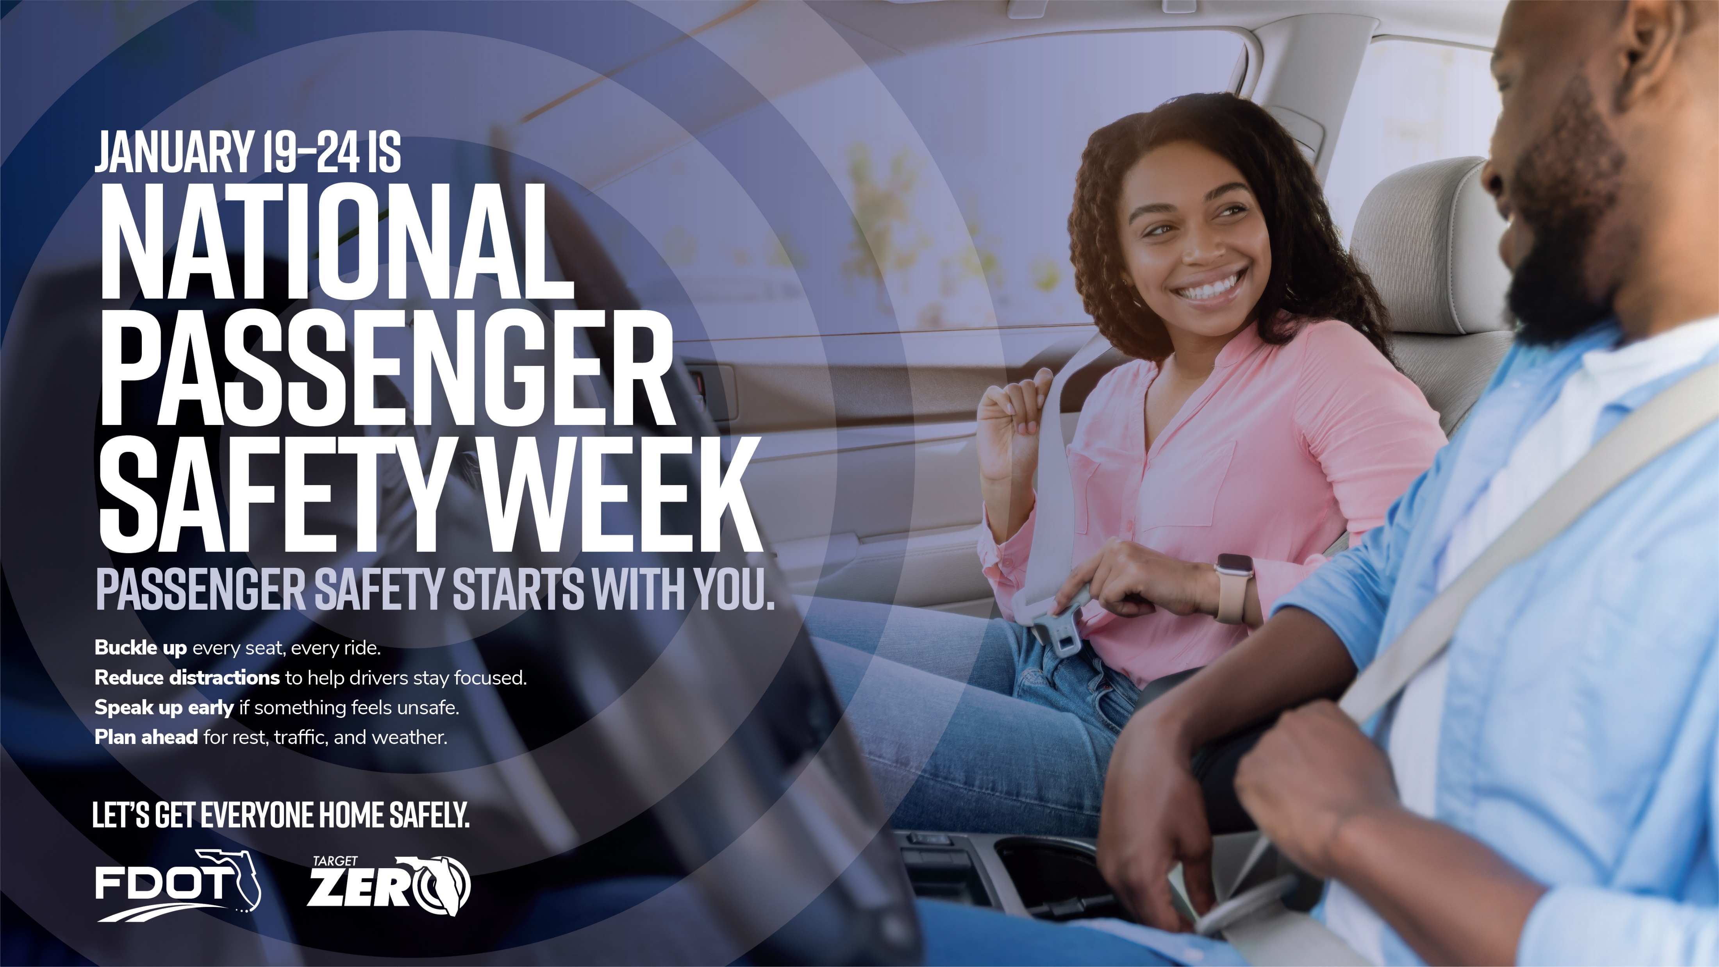
Notes:
The National Perspective
In 2023, NHTSA reported 40,901 motor vehicle traffic deaths. Passenger vehicle occupants accounted for 20,959 of those lives lost, approximately 59%. Of those passenger vehicle fatalities, 49% were not wearing seatbelts according to known usage at the time of the crash.
Buckling up is the simplest, safest thing you can do on any ride.
Teen Drivers and Passenger Safety
According to NHTSA, traffic crashes are the leading cause of death for teens in the United States. In 2023, 2,611 people were killed in crashes involving teen drivers.
Of these fatalities:
822 were the teen driver
604 were the passengers of teen drivers
377 of those passengers were other teens riding with a teen driver, and
87,074 teen drivers were injured in traffic crashers.
Have open conversations with teens in your life about safe driving practices and how to politely and kindly speak up if a ride doesn’t feel safe. Offer to be a back-up ride in any case where they may not be comfortable.
Driver Condition and Passenger Safety
Distracted driving, drunk driving, and drowsy driving accounted for a cumulative 16,337 lives lost in the US in 2023, according to NHTSA. Passengers can play a part in overall safety when it comes to driver and road conditions. Whether it’s limiting distractions, helping with navigation or messages, offering to takeover on long drives, or arranging a safe alternative ride, passengers can help reduce rick and support safer trips for everyone in a vehicle.
Speak up early, politely, and clearly if something doesn’t feel safe – even small conversations can prevent serious consequences and help everyone get home safely.
Resources:
Florida Occupant Protection Coalition - http://www.floccupantprotection.com/
Florida Teen Safe Driving Coalition - https://flteensafedriver.org/
NHTSA Risky Driving Topics - https://www.nhtsa.gov/risky-driving
Sources
NHTSA Research: https://crashstats.nhtsa.dot.gov/Api/Public/ViewPublication/813705
Seatbelt Safety: https://www.nhtsa.gov/vehicle-safety/seat-belts
Teen Driving: https://www.trafficsafetymarketing.gov/safety-topics/teen-driver-safety

