Slide 1
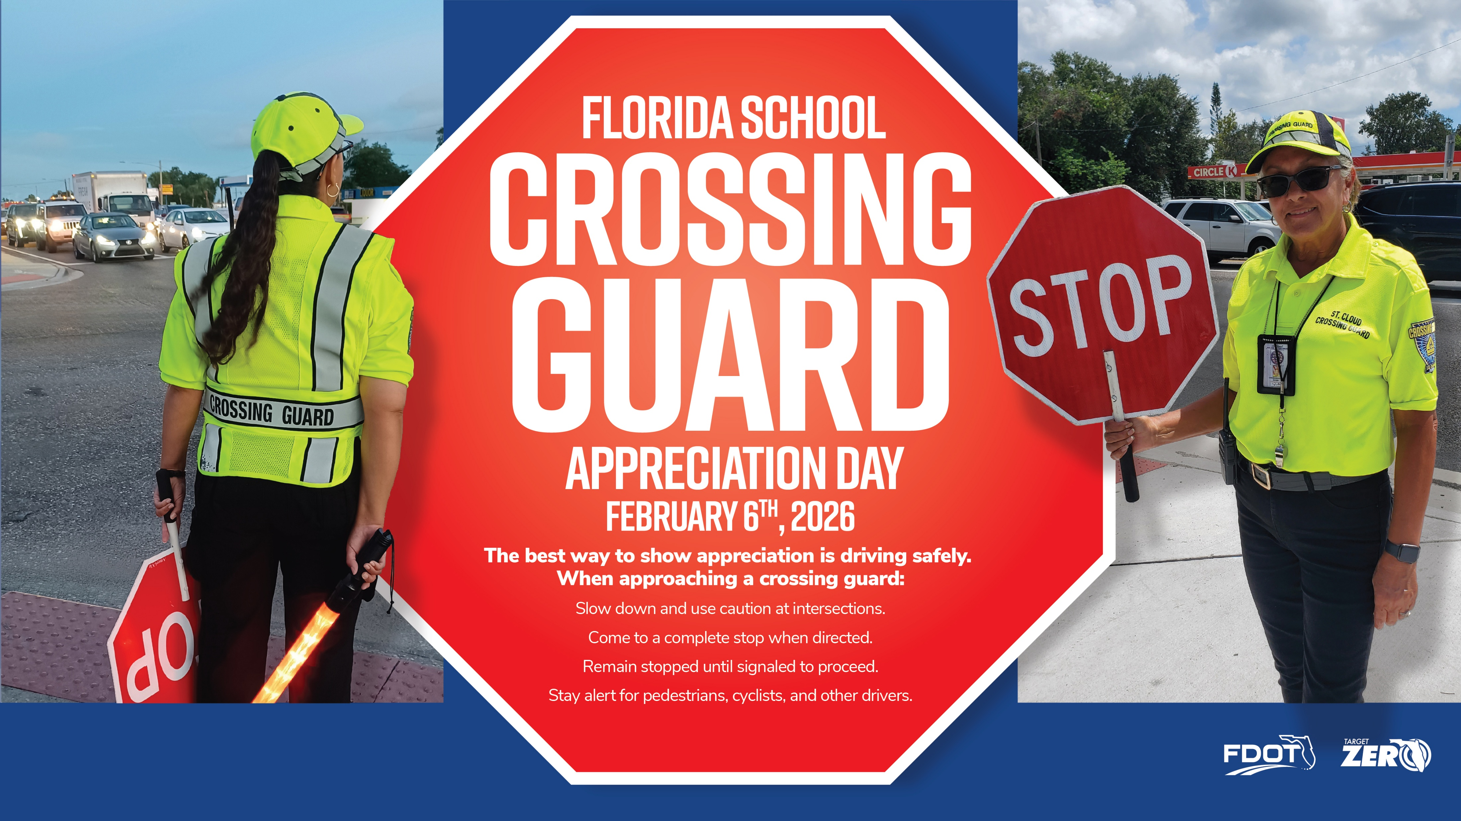
Notes:
February 6 is Florida School Crossing Guard Appreciation Day!
Each weekday across the state, crossing guards are out at school entrances, crosswalks, and busy intersections, helping students and families cross safely. Their presence improves visibility, supports safer school zones, and reinforces safe driving behavior in areas with high pedestrian activity.
Florida law includes several protections to support this work, including reduced speed limits in school zones, restrictions on handheld device use, and enhanced penalties for violations.
The state also allows automated speed enforcement in school zones to help reinforce compliance during school hours.
Showing appreciation takes many forms, so take a moment on February 6th to thank your local crossing guard and prioritize safety in your local school zones and around your community.
To learn more about crossing guards and related safety topics, check out these resources:
- FDOT’s Crossing Guard Training Program Page: https://www.fdot.gov/Safety/programs/schoolcrossingguard.shtm
National Highway Traffic Safety Association’s Child Pedestrian Safety Curriculum page: https://www.nhtsa.gov/pedestrian-safety/child-pedestrian-safety-curriculum
Florida Department of Highway Safety and Motor Vehicle’s safety tips for both pedestrians and drivers: https://www.flhsmv.gov/safety-center/driving-safety/pedestrian-safety/

Slide 2
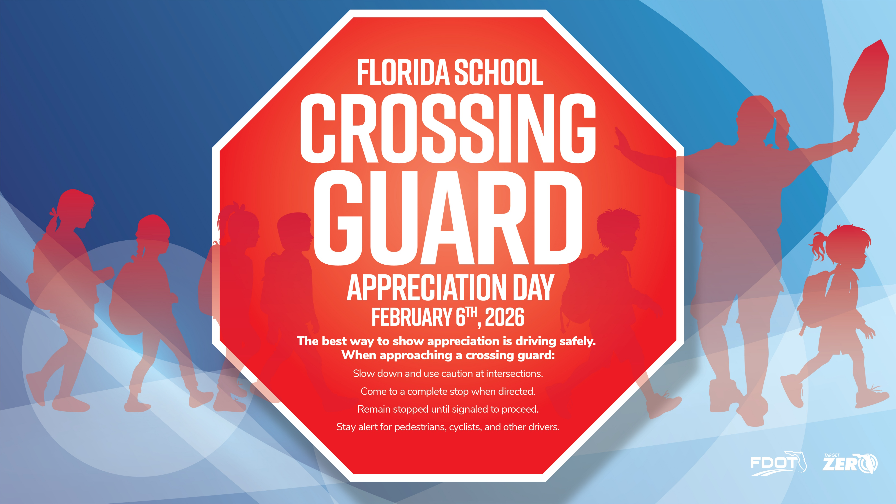
Notes:
February 6 is Florida School Crossing Guard Appreciation Day!
Each weekday across the state, crossing guards are out at school entrances, crosswalks, and busy intersections, helping students and families cross safely. Their presence improves visibility, supports safer school zones, and reinforces safe driving behavior in areas with high pedestrian activity.
Florida law includes several protections to support this work, including reduced speed limits in school zones, restrictions on handheld device use, and enhanced penalties for violations.
The state also allows automated speed enforcement in school zones to help reinforce compliance during school hours.
Showing appreciation takes many forms, so take a moment on February 6th to thank your local crossing guard and prioritize safety in your local school zones and around your community.
To learn more about crossing guards and related safety topics, check out these resources:
- FDOT’s Crossing Guard Training Program Page: https://www.fdot.gov/Safety/programs/schoolcrossingguard.shtm
National Highway Traffic Safety Association’s Child Pedestrian Safety Curriculum page: https://www.nhtsa.gov/pedestrian-safety/child-pedestrian-safety-curriculum
Florida Department of Highway Safety and Motor Vehicle’s safety tips for both pedestrians and drivers: https://www.flhsmv.gov/safety-center/driving-safety/pedestrian-safety/

