Slide 1
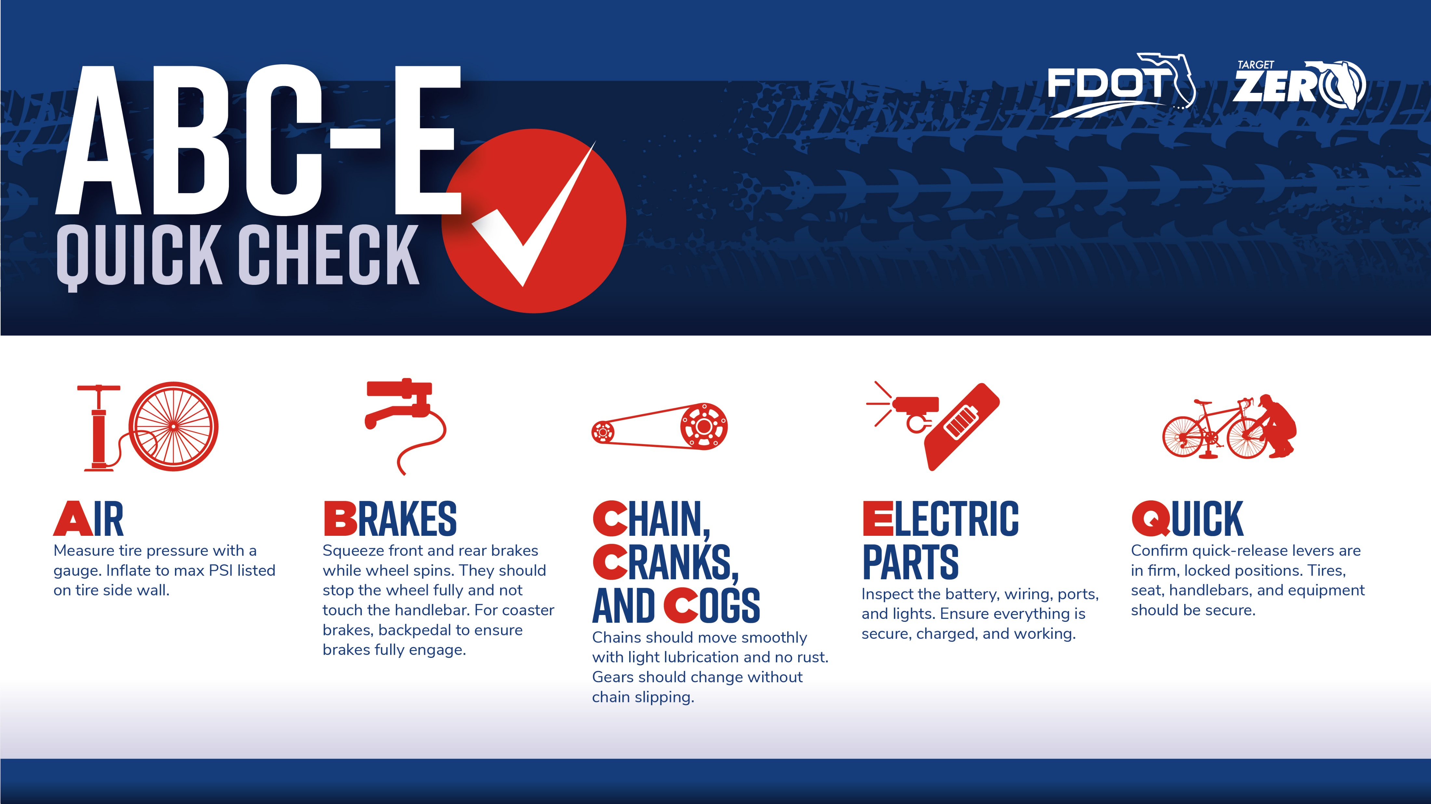
Notes:
Before each ride, make sure your e-bike is in working condition using the ABC-E quick check.
A — Check the air in your tires. They should be inflated to the max-rated PSI.
B — Brakes should stop the bike when pushed forward or pulled backwards. Lever should stop short of reaching the handlebar when pulled.
C — The chain should move freely, be free of rust, and slightly oiled.
E— Check the electric components of your bike – the battery, any visible wiring or ports, and the lights.
The better you know your equipment, the safer and smoother your ride. Check tires, brakes, chain, and electronics before every ride. It takes less than a minute and can prevent crashes.

